Slide 1
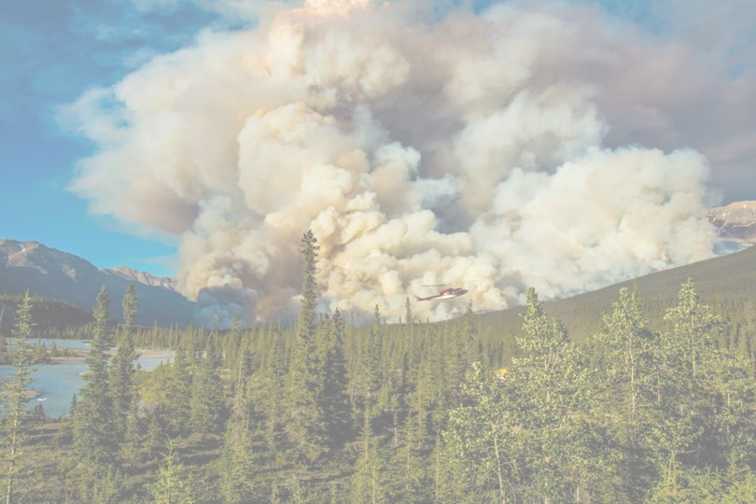
Biomass-based cellular automaton for exploring wildfire
By J Kahn and Helen Miller
QERM 497
March 7, 2023

Slide 2
Presentation Roadmap
Ecological Context
Model Description
Experiments + Results
Conclusions
Notes:
H – Ecological context + model description
J – Experiments and Results + conclusions

Slide 3
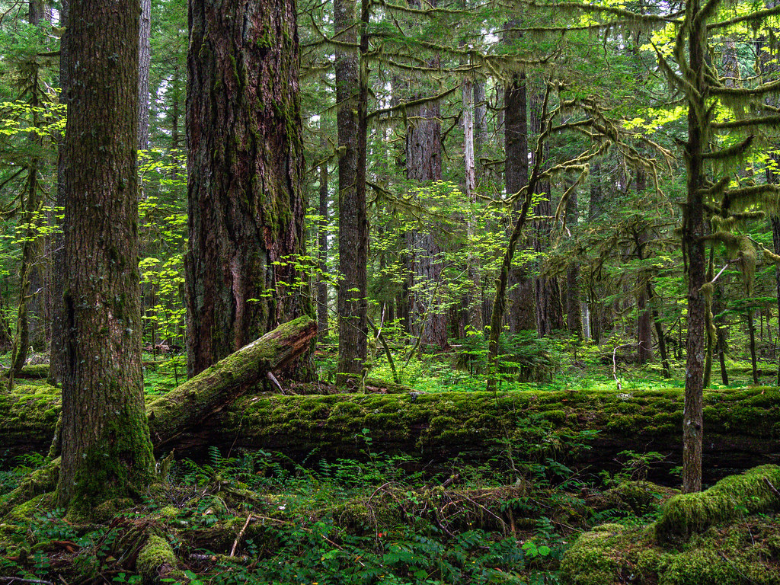
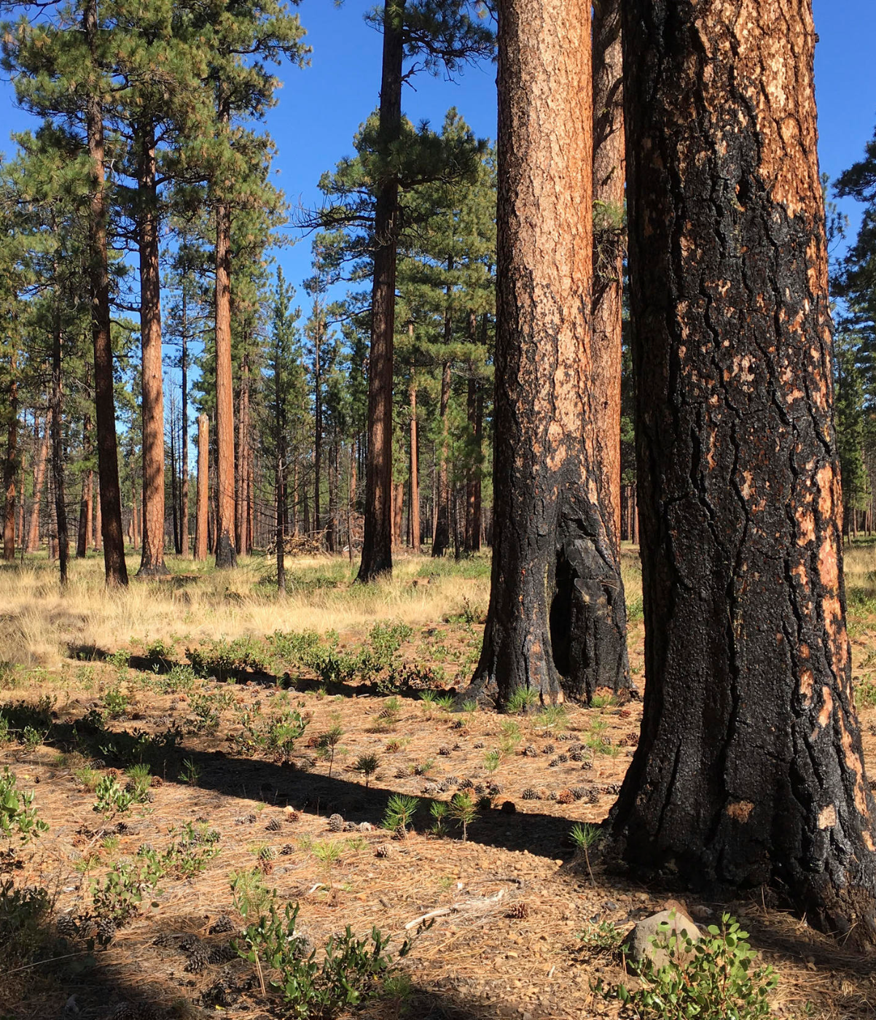
Ecological Context
Western Cascade forest
Eastern Cascade forest
High precipitation
High biomass accumulation
Infrequent, high-severity wildfire
Dry climate
Sparser forest, lower biomass
Frequent, lower-severity wildfire
Notes:
https://www.flickr.com/photos/sigmaeye/49928298063/
http://www.knkx.org/post/fighting-fire-fire-prescribed-burn-training-tackles-forest-health-washington

Slide 4
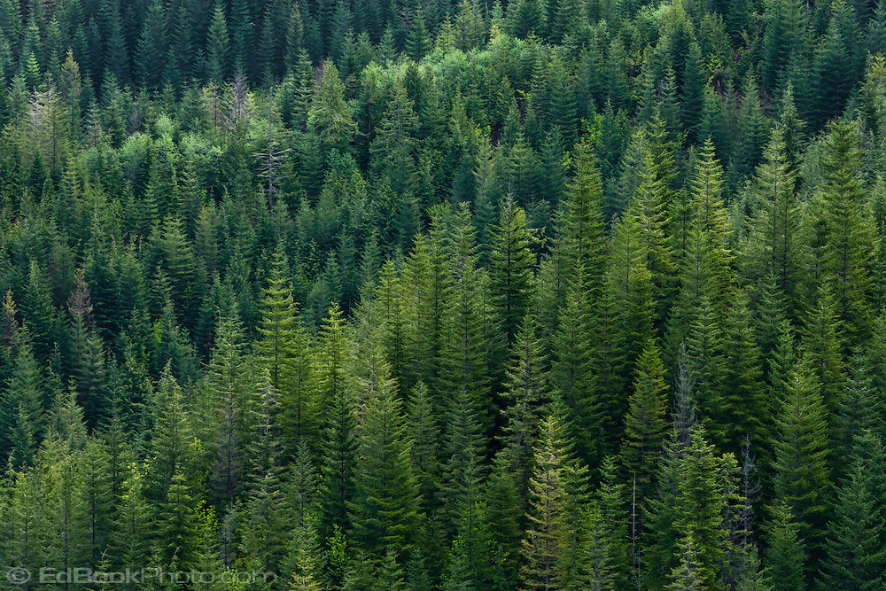
Our Research Questions:
1) Can we create a simple model that qualitatively replicates eastside vs westside fire dynamics?
2) Which parameters are most important for generating these differing dynamics?
Image source
Notes:
Source:

Slide 5
Presentation Roadmap
Ecological Context
Model Description
Experiments + Results
Conclusions
Notes:
H – Ecological context + model description
J – Experiments and Results + conclusions

Slide 6


Model Set up
Cellular automata model on 2d grid
Fixed boundary conditions
Each cell takes on a biomass value
varies between 0 and its maximum biomass
ASH
VEGETATION

Slide 7

Simulation
GROWTH SEASON
FIRE SEASON
Before
Alternate between growth season and fire season for n years
usually takes around 100-200 for dynamics to stabilize
Growth season: Vegetation increases in biomass and propagates to new cells
Fire season: Fires ignite, spread and burn out
After

Slide 8
Growth Season

Slide 9
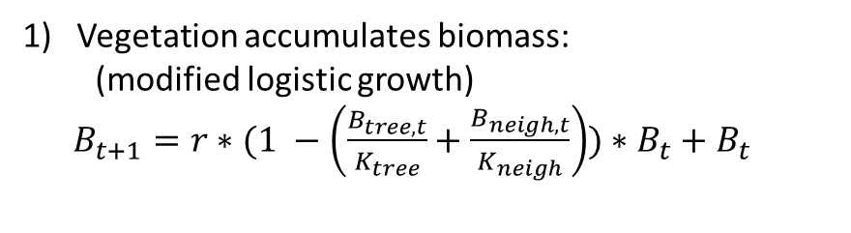
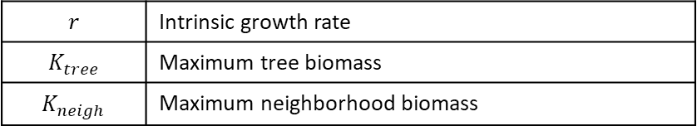
Growth Season
Vegetation accumulates biomass:
(modified logistic growth)
$B_{t+1}=r∗(1 −\left(\frac{B_{tree, t}}{K_{tree}}+\frac{B_{neigh, t}}{K_{neigh}}\right))∗B_{t}+$ $B_{t}$
$$r$$ | Intrinsic growth rate
$$K_{tree}$$ | Maximum tree biomass
$$K_{neigh}$$ | Maximum neighborhood biomass

Slide 10
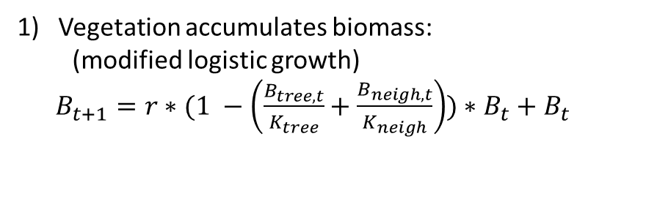
Growth Season
Vegetation accumulates biomass:
(modified logistic growth)
$B_{t+1}=r∗(1 −\left(\frac{B_{tree, t}}{K_{tree}}+\frac{B_{neigh, t}}{K_{neigh}}\right))∗B_{t}+$ $B_{t}$
$$r$$ | Intrinsic growth rate
$$K_{tree}$$ | Maximum tree biomass
$$K_{neigh}$$ | Maximum neighborhood biomass

Slide 11
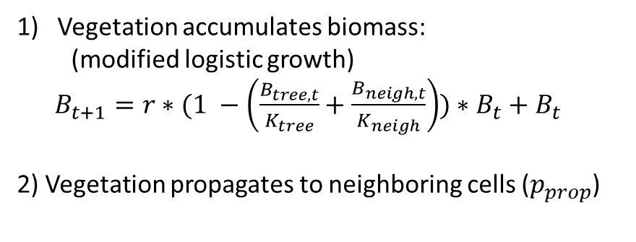
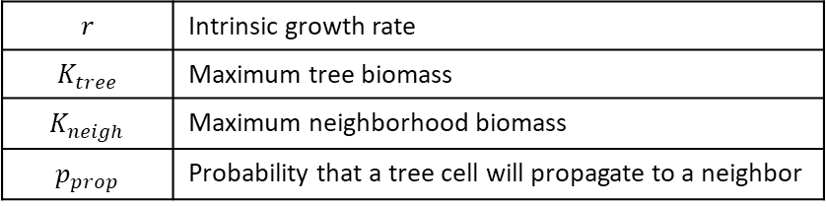
Growth Season
Vegetation accumulates biomass:
(modified logistic growth)
$B_{t+1}=r∗(1 −\left(\frac{B_{tree, t}}{K_{tree}}+\frac{B_{neigh, t}}{K_{neigh}}\right))∗B_{t}+$ $B_{t}$
2) Vegetation propagates to neighboring cells ($p_{prop}$)
$$r$$ | Intrinsic growth rate
$$K_{tree}$$ | Maximum tree biomass
$$K_{neigh}$$ | Maximum neighborhood biomass
$$p_{prop}$$ | Probability that a tree cell will propagate to a neighbor

Slide 12
Growth Season
Vegetation accumulates biomass:
(modified logistic growth)
$B_{t+1}=r∗(1 −\left(\frac{B_{tree, t}}{K_{tree}}+\frac{B_{neigh, t}}{K_{neigh}}\right))∗B_{t}+$ $B_{t}$
2) Vegetation propagates to neighboring cells ($p_{prop}$)
$$r$$ | Intrinsic growth rate
$$K_{tree}$$ | Maximum tree biomass
$$K_{neigh}$$ | Maximum neighborhood biomass
$$p_{prop}$$ | Probability that a tree cell will propagate to a neighbor

Slide 13
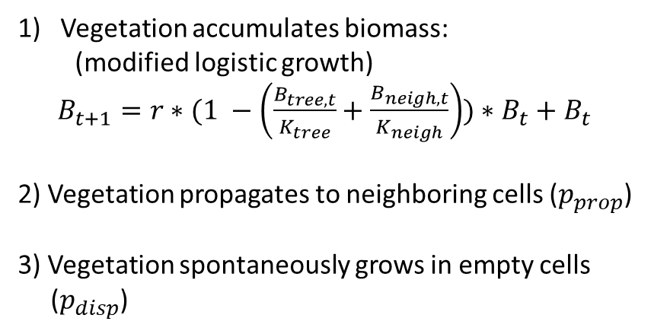
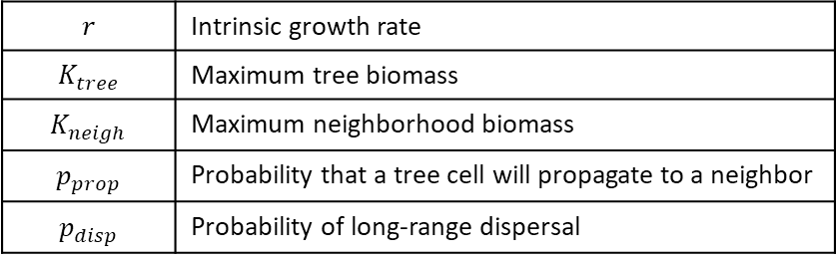
Growth Season
Vegetation accumulates biomass:
(modified logistic growth)
$B_{t+1}=r∗(1 −\left(\frac{B_{tree, t}}{K_{tree}}+\frac{B_{neigh, t}}{K_{neigh}}\right))∗B_{t}+$ $B_{t}$
2) Vegetation propagates to neighboring cells ($p_{prop}$)
3) Vegetation spontaneously grows in empty cells
($p_{disp}$)
$$r$$ | Intrinsic growth rate
$$K_{tree}$$ | Maximum tree biomass
$$K_{neigh}$$ | Maximum neighborhood biomass
$$p_{prop}$$ | Probability that a tree cell will propagate to a neighbor
$$p_{disp}$$ | Probability of long-range dispersal

Slide 14
Growth Season
Vegetation accumulates biomass:
(modified logistic growth)
$B_{t+1}=r∗(1 −\left(\frac{B_{tree, t}}{K_{tree}}+\frac{B_{neigh, t}}{K_{neigh}}\right))∗B_{t}+$ $B_{t}$
2) Vegetation propagates to neighboring cells ($p_{prop}$)
3) Vegetation spontaneously grows in empty cells
($p_{disp}$)
$$r$$ | Intrinsic growth rate
$$K_{tree}$$ | Maximum tree biomass
$$K_{neigh}$$ | Maximum neighborhood biomass
$$p_{prop}$$ | Probability that a tree cell will propagate to a neighbor
$$p_{disp}$$ | Probability of long-range dispersal

Slide 15
Fire Season

Slide 16
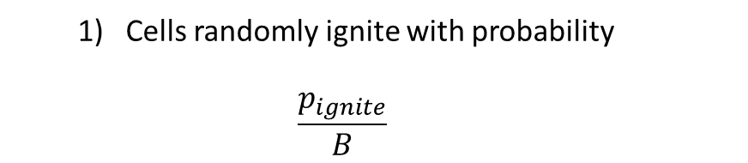
Fire Season
Cells randomly ignite with probability
$$\frac{p_{ignite}}{B}$$
$$p_{ignite}$$ | Probability of ignition when biomass = 1

Slide 17
Fire Season
Cells randomly ignite with probability
$$\frac{p_{ignite}}{B}$$
$$p_{ignite}$$ | Probability of ignition when biomass = 1

Slide 18
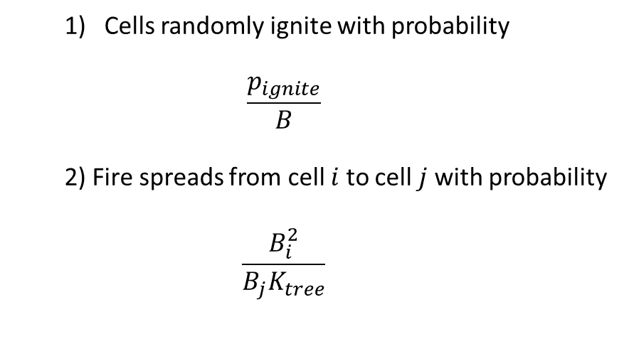
Fire Season
Cells randomly ignite with probability
$$\frac{p_{ignite}}{B}$$
2) Fire spreads from cell $i$to cell $j$with probability
$$\frac{B_{i}^{2}}{B_{j}K_{tree}}$$
$$p_{ignite}$$ | Probability of ignition when biomass = 1

Slide 19
Fire Season
Cells randomly ignite with probability
$$\frac{p_{ignite}}{B}$$
2) Fire spreads from cell $i$to cell $j$with probability
$$\frac{B_{i}^{2}}{B_{j}K_{tree}}$$
$$p_{ignite}$$ | Probability of ignition when biomass = 1

Slide 20
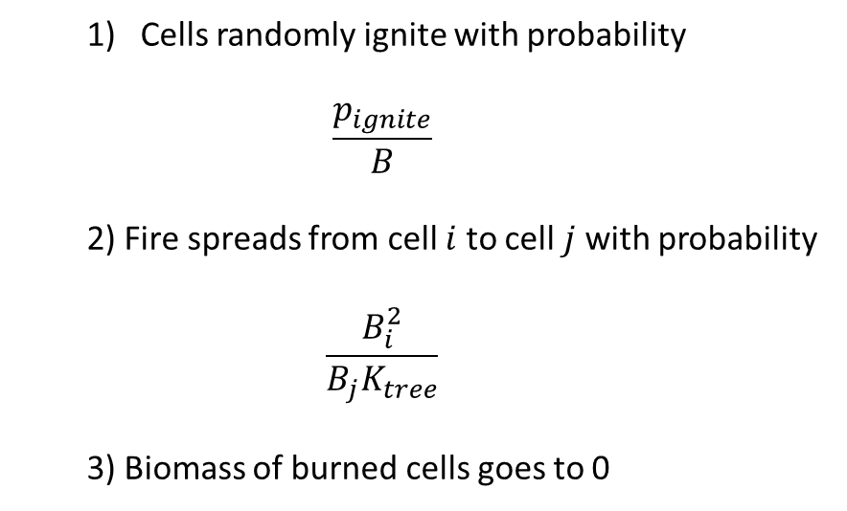
Fire Season
Cells randomly ignite with probability
$$\frac{p_{ignite}}{B}$$
2) Fire spreads from cell $i$to cell $j$with probability
$$\frac{B_{i}^{2}}{B_{j}K_{tree}}$$
3) Biomass of burned cells goes to 0
$$p_{ignite}$$ | Probability of ignition when biomass = 1

Slide 21
Fire Season
Cells randomly ignite with probability
$$\frac{p_{ignite}}{B}$$
2) Fire spreads from cell $i$to cell $j$with probability
$$\frac{B_{i}^{2}}{B_{j}K_{tree}}$$
3) Biomass of burned cells goes to 0
$$p_{ignite}$$ | Probability of ignition when biomass = 1

Slide 22
Presentation Roadmap
Ecological Context
Model Description
Experiments + Results
Conclusions
Notes:
H – Ecological context + model description
J – Experiments and Results + conclusions

Slide 23
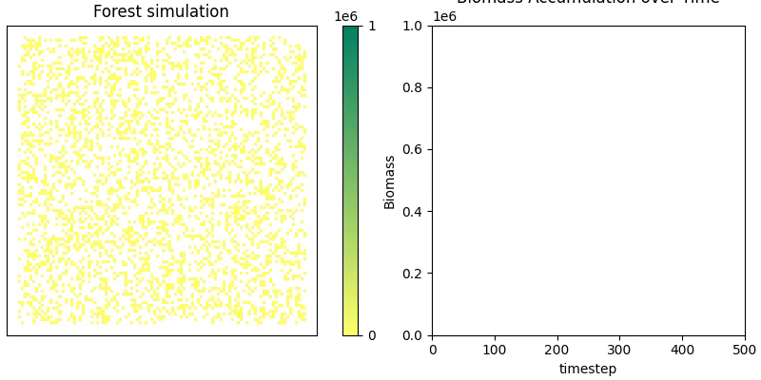
Biomass accumulation over time

Slide 24
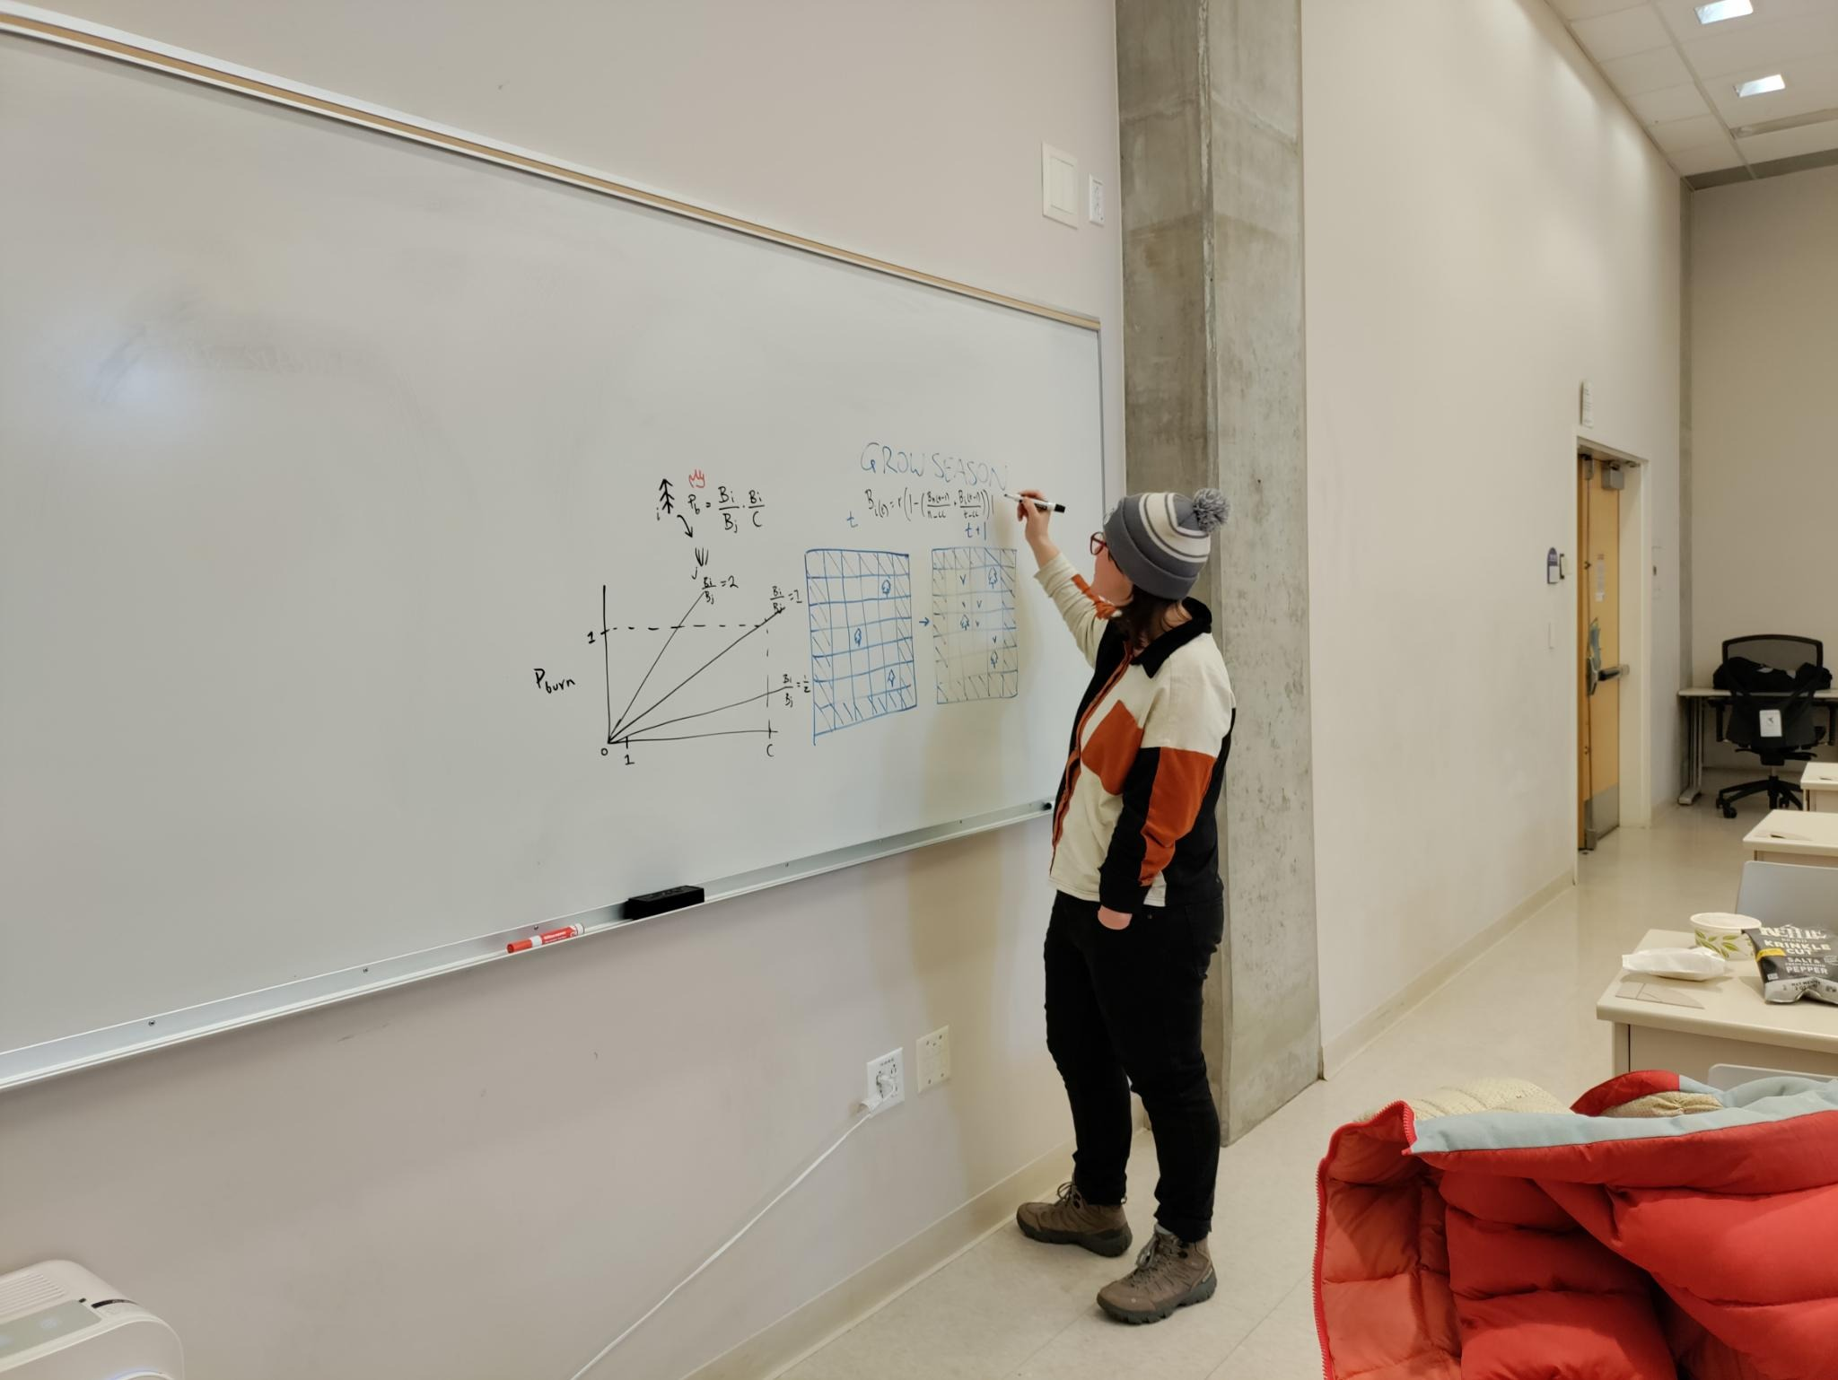
Experiments
2) Eastside vs Westside dynamics
1) Parameter Sweeps

Slide 25
Experiment Set #1: Parameter Sweeps
Vary:
Max Biomass Ratio
Intrinsic growth rate
Tree Max Biomass
Ignition Probability
Max
Mean
Min
Visual:
Biomass
Parameter value

Slide 26
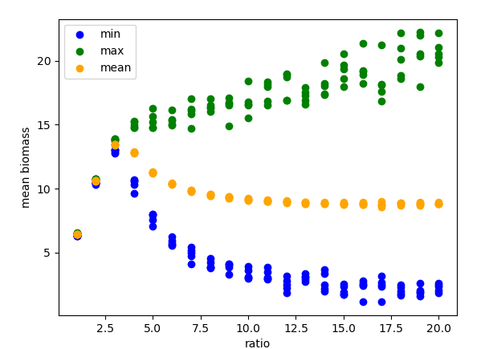
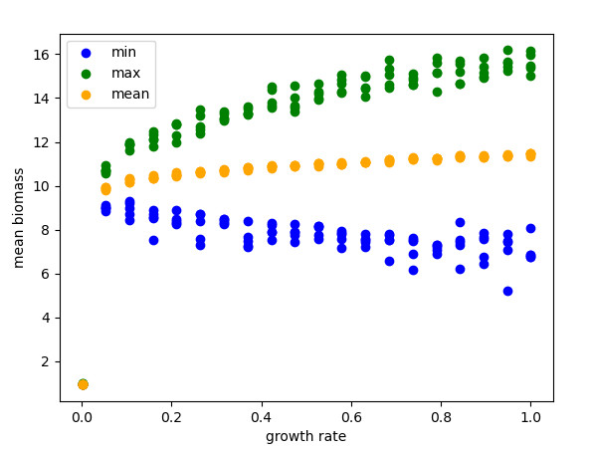
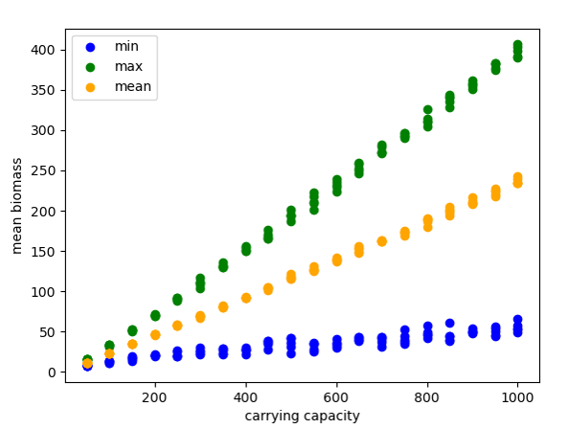
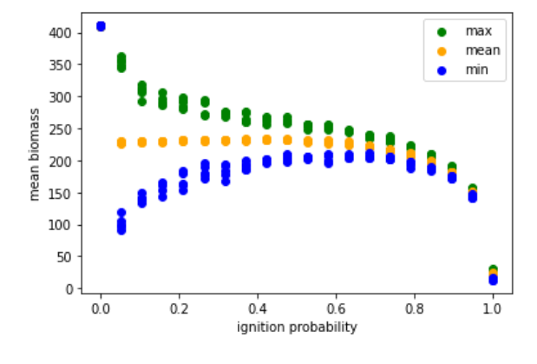
Max Biomass Ratio
Intrinsic Growth Rate
[plots + interpretation]
Change in dynamics
Tree Max Biomass
Ignition Probability
Bigger gap = bigger oscillations
Notes:
Qualitative differences:
Higher growth rate = more oscillations
Two dynamics: At low nieghborhood carrying capacity (like resource competition) – no oscillations; higher is oscillations
Ignition probability – lower = more oscillatory (at 1 everything burns all the time)

Slide 27
Experiment Set #2: Eastside vs Westside Dynamics
Vary:
Hand-picked “westside” vs “eastside” parameters
For a characteristic time point:
Over time:
For all time:
Visual:
Biomass
Freq
Time
Area burned
Notes:
Ran for 500 years, L=50

Slide 28
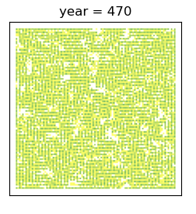
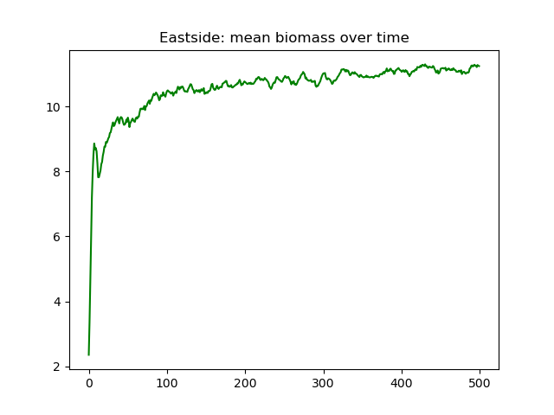
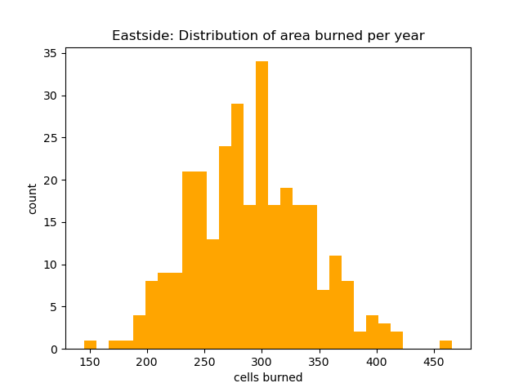

“Eastside” forest: high competition, high ignition prob
$$K_{neigh}=2.5∗K_{tree}$$
$$p_{ignite}=0.05$$
Notes:
Histogram is after burnout time (200 years)

Slide 29
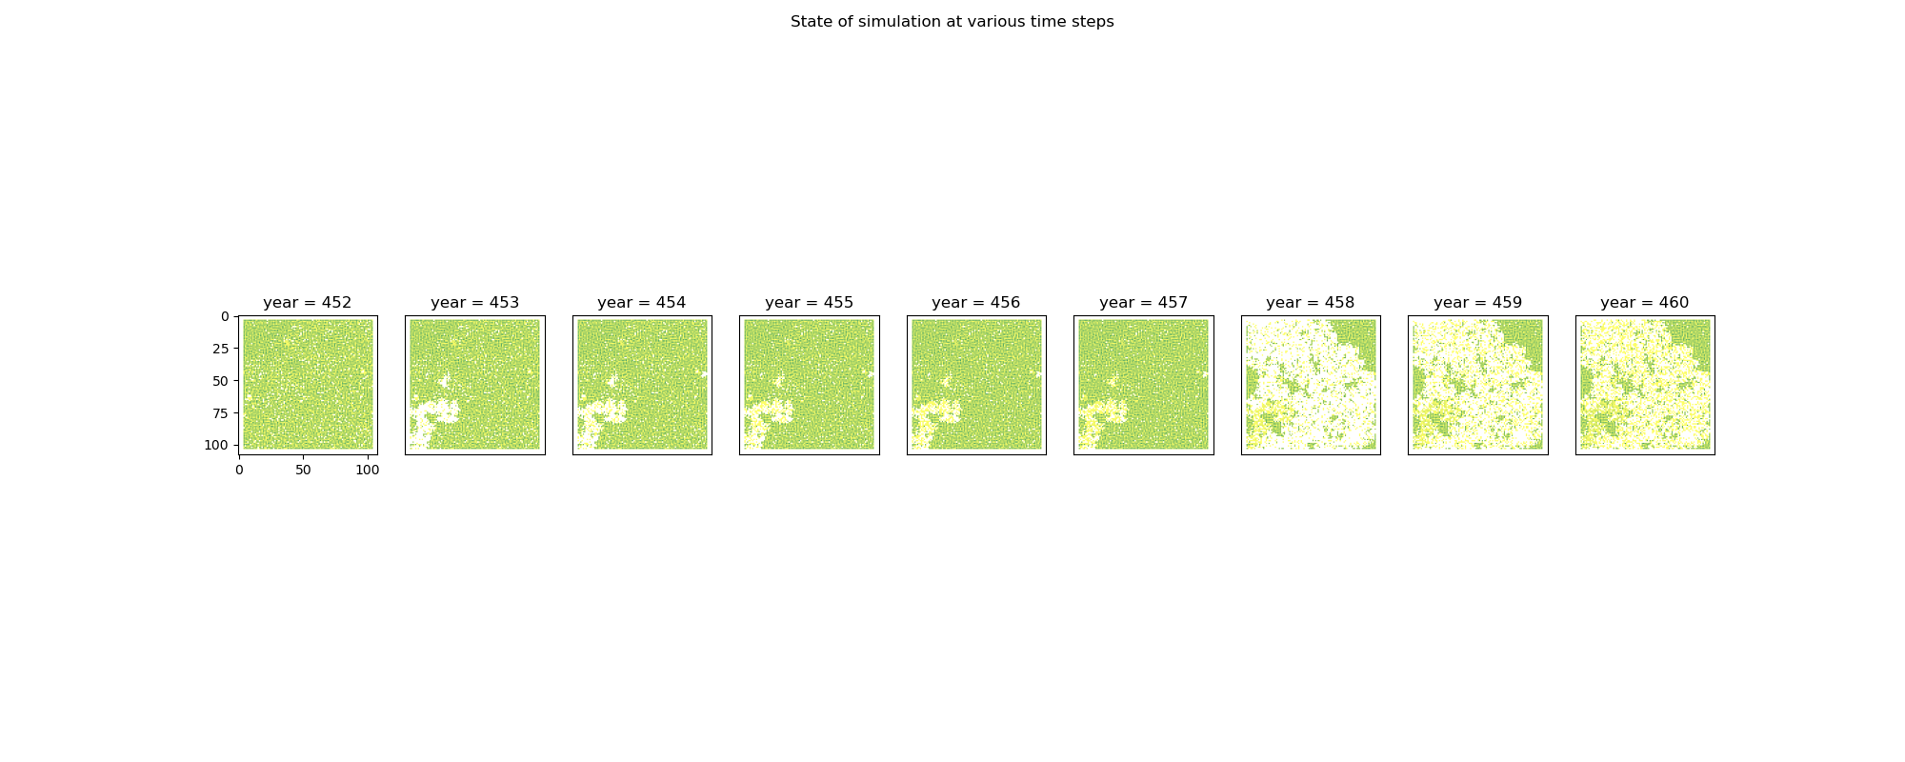
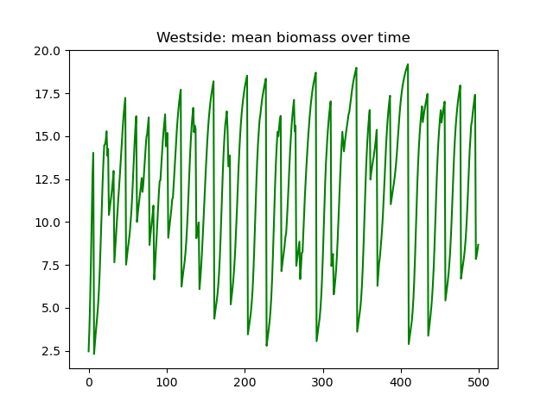
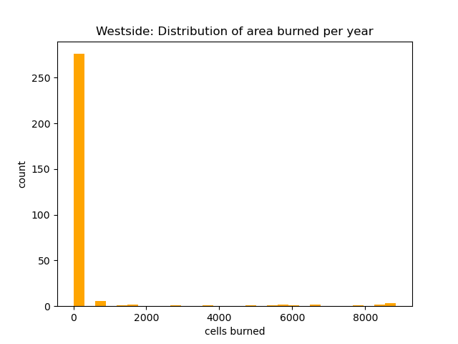

“Westside” forest: low competition, low ignition prob
$$K_{neigh}=5∗K_{tree}$$
$$p_{ignite}=0.001$$
Notes:
Histogram is after burnout time (200 years)

Slide 30
Presentation Roadmap
Ecological Context
Model Description
Experiments + Results
Conclusions
Notes:
H – Ecological context + model description
J – Experiments and Results + conclusions

Slide 31
Conclusions
The Good:
Our model did recover some environmental differences (more resource limited system/smaller burns vs less limited/bigger burns)
The main parameters that seem to drive differing dynamics are ratio of max tree to neighborhood biomass (representing resource limitations) and ignition probability

Slide 32
Conclusions
The Limitations:
Linear relationship bt source size and probability of fire spreading caused semi-unrealistic dynamics
Tiny little grass fires almost never propagate bc of how we generate burn probabilities
More realistic would maybe be to have a non-linear relationship
Would not use fixed boundary conditions next time (artifacts on edges)

Slide 33
Thank you!

Slide 34
Questions?

Slide 35
Model Setup
Cellular automata model on a 2-D grid
Fixed boundary conditions (natural barriers)

Slide 36
Fire season
Before
Ignitions
Ignitions

Slide 37
Conclusions
Our model is fine
Main parameters that seem to drive diff dynamics are: ratio,
[more stuff]
“Your model is sick. Super sick man!” – Brooke Nelson

Slide 38
Experiment Set #1
Varying ratio of tree_CC / neighborhood_CC
Varied from 1-20
Made a cool plot of mean, max, min biomass
Found: when ratio < 3, do not see oscillations in biomass; when ratio >3, we do (and amplitude of oscillations increases with ratio)
HOWEVER, mean biomass does not continue increasing after ratio >3

Slide 39
Experiment #2
(choose CCratio to be 5)
Varying intrinsic rate of growth between (almost) 0 and 1
Result: no qualitative change to mean/min/max biomass dynamics over time, but oscillations in biomass got larger with higher growth rate

